Slide 1

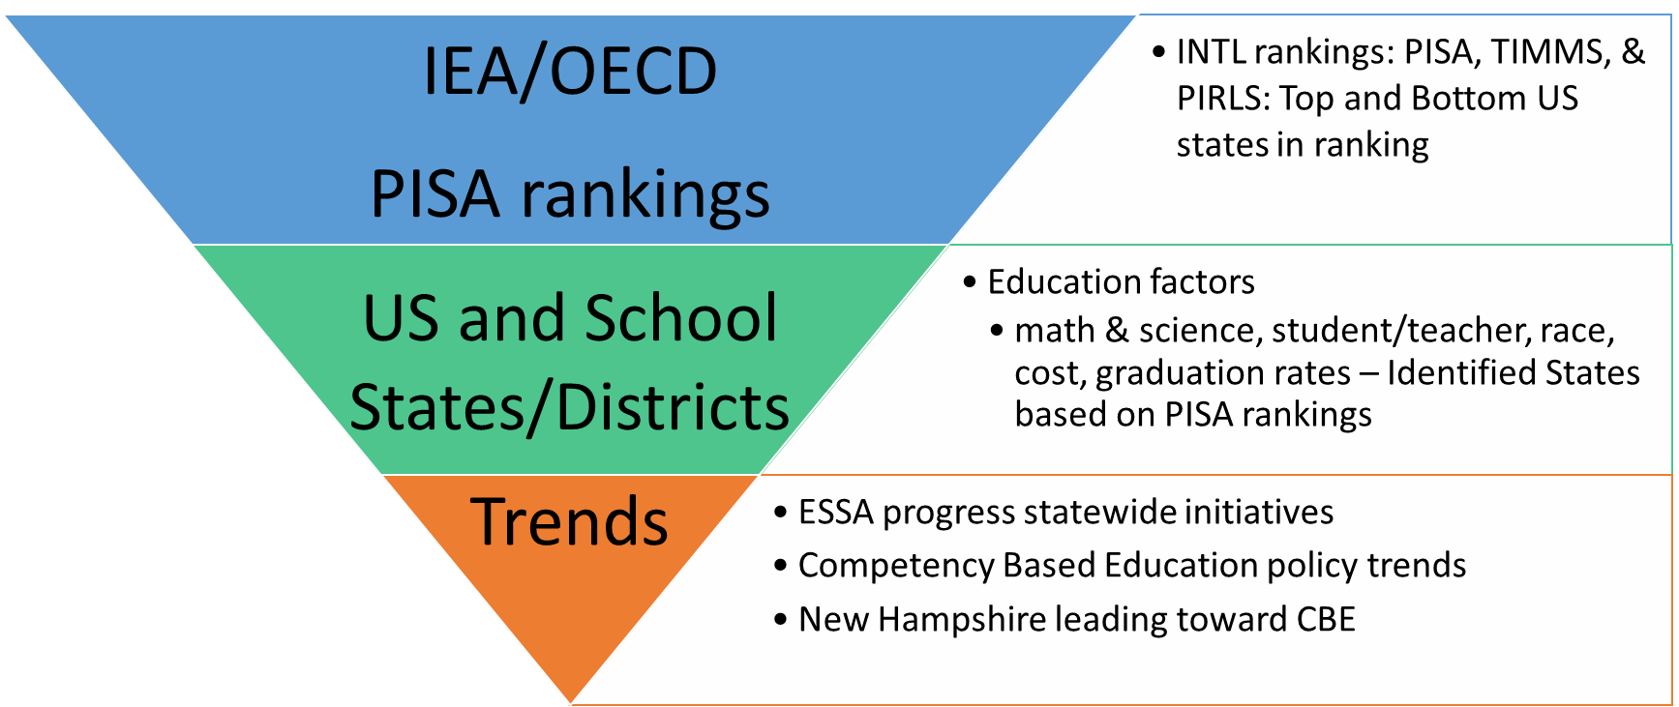
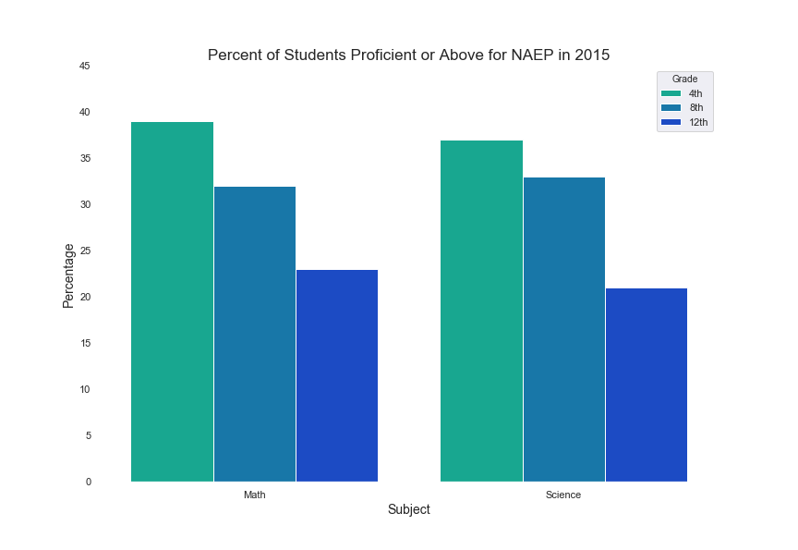
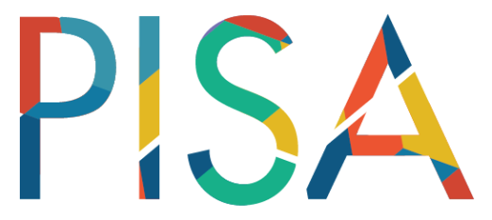
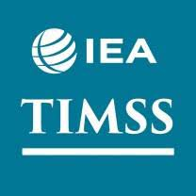

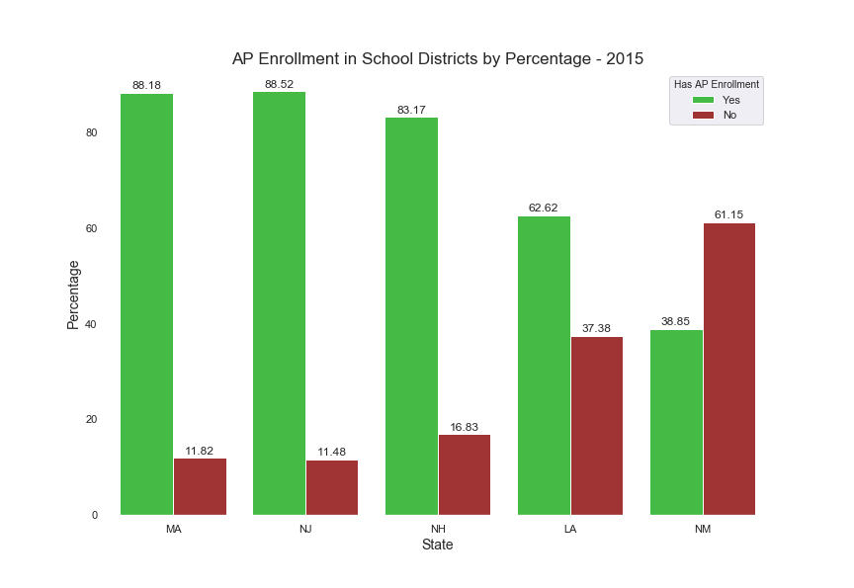
Status of US K-12 Public-School Education
Nathan Harris, Sindhu Veeramachaneni, Zachary Zalman
Department of Analytics, University of New Hampshire
Introduction
International
National
At the international level, there are several tests administered to test various areas of education: The Trends in International Mathematics and Science Study (TIMSS) for math and science, the Progress In International Reading Literacy Study (PIRLS) for reading, and the Program for International Student Assessment (PISA) for math, science, and reading. The PISA is done in 72 countries and examines 15 yr. old students. In this study, the US ranks 31st, not that high. It also shows a sharp decline from 4th and 8th grade scores (TIMMS & PIRLS). The gains of early education are not sustainable in the later years​
The National Assessment of Education Progress (NAEP) assessment is a federally run test to look at various grades and subjects within the US. In 2015, the percent of students who are proficient in Math and Science show steady declines across grades. Decreasing proficiency as students advance through grades is an indicator of a decline in education quality as students advance.
This project is an examination of public-school education in the United States. The focus starts with a look at the international status of the US, and drops down to the district level for a few states selected from the top and bottom of the rankings
Methodology
District
New Hampshire
The first stage of the project was to determine the focus. After initial investigation and debate, the decision was made to create a multi-level approach to look at the issue from a broad look all the way down to a more focused perspective.
For the international level, it was decided to focus of PISA for the broad scale it offered. Other data from other sources was sued to supplement the findings from PISA.
At the national level , the NAEP assessment was used to get information about state-level scores in math and science across 4th, 8th, and 12th grade students.
For the district level data, five states were chosen to represent the top and bottom of the US rankings. New Jersey, Massachusetts, and New Hampshire were at the top, and New Mexico and Louisiana were at the bottom.
New Hampshire was also focused on to show the effects of Competency-based education.
Data was collected from numerous sources for each level to get as complete as possible data.
Python was the primary tool used to clean and join data together, and Tableau and Python (Seaborn) were used to generate the visualizations
Five states were chosen to examine at the district-level. MA, NJ, and NH were high ranking states, while LA and NM were low ranking. Looking at district-level AP enrollment in these states should interesting results; top ranked states had high levels of districts with students enrolling in AP classes, while bottom ranked states had much lower levels. This leads to the possibility that having AP classes offered at the school may improve student's education quality
New Hampshire is one of the leaders in competency-based education, a method of teaching that promotes mastery of the subject taught. The traditional style is the Carnegie Unit, which is a purely time-based method.
NH developed the Performance Assessment of Competency Education (PACE)​ system, a first-of-its-kind pilot that replaces standardized tests with personalized, authentic assessments developed by New Hampshire teachers.​ It was implemented following the implementation of the Every Student Succeeds Act (ESSA) at the national level.
Since NH remains near the top of the rankings in science and math, the use of competency-based education seems to have some success. Additionally, over the past few years, more states are developing competency-based education plans, including NJ, MA, LA, and NM.
Important Findings
International Assessment(s) mirrors USA high School decline in math and science.
AP enrollment in general is higher for better ranked states.
ESSA (Every Student Succeeds Act) is reshaping assessment and accountability requirements.
Competency state-based education initiatives are increasing in high percentage across the country.
References
National Science Foundation
National Assessment of Education Progress
U.S. Department of Education
National Education
National Center for Education Statistics
KnowledgeWorks
Organization for Economic Cooperation & Development
International Educational Association

